Slide 1
Mushroom Town Project
By Alyssa K. Jakob T. Pieter V.

Slide 2
Alyssa’s Creations
Redcap Mushrooms and a Browncap Mushroom
Browncap Improvements

Slide 3
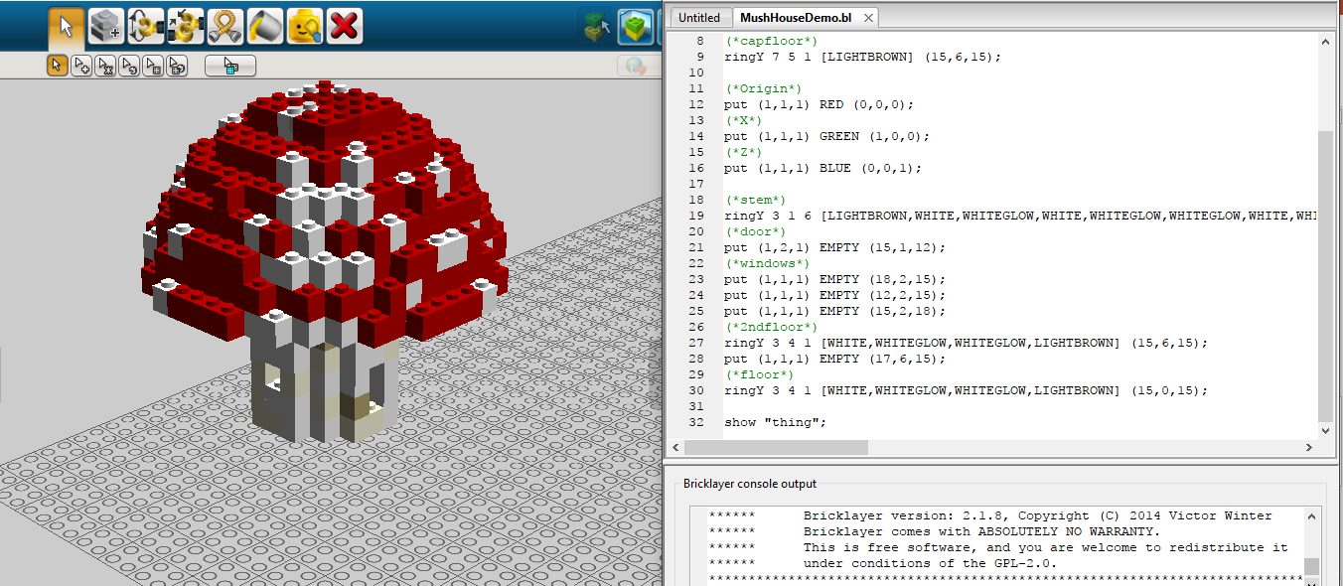
Redcap Mushroom 1

Slide 4
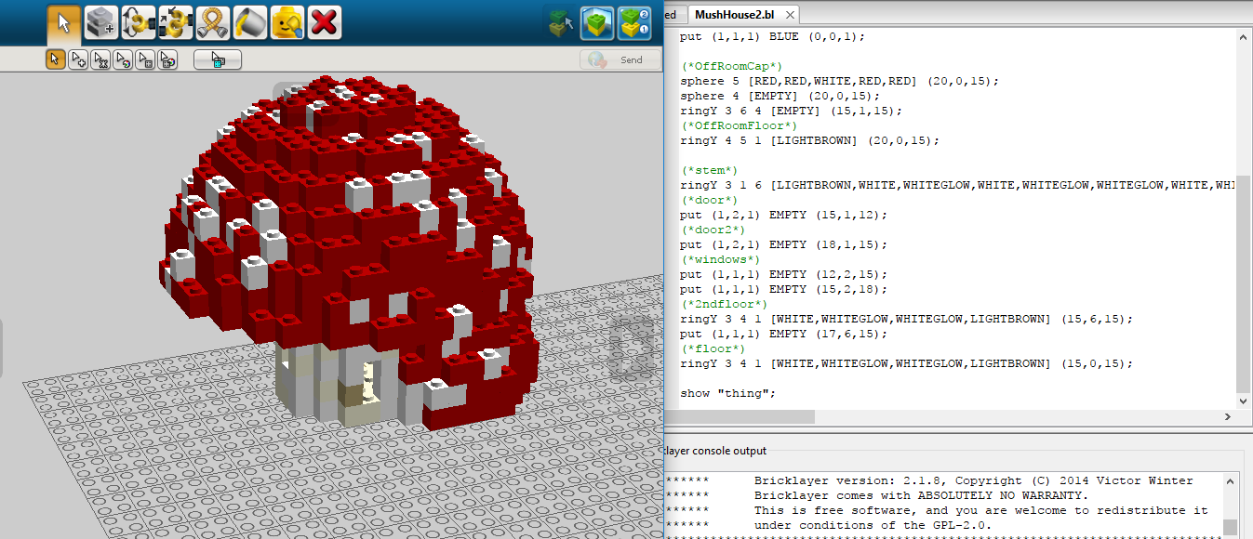
Redcap Mushroom 2

Slide 5
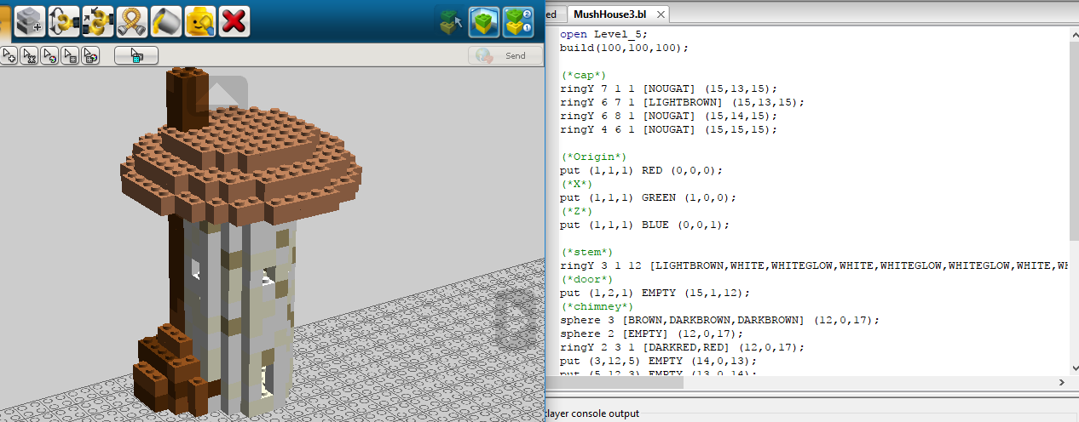
Browncap Mushroom 1

Slide 6
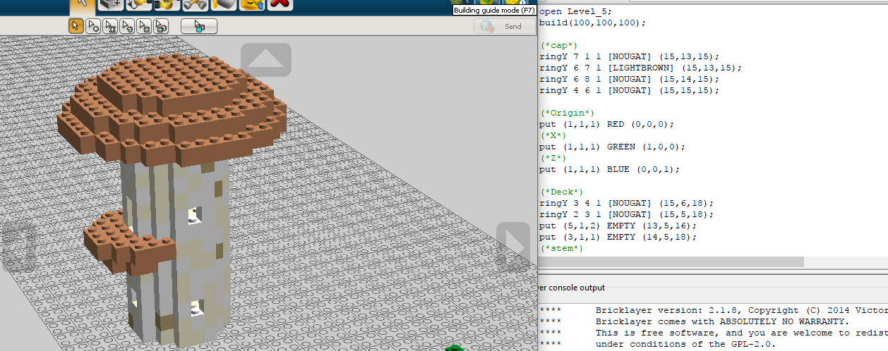
Browncap Mushroom 2

Slide 7
Jakob’s Creations
Browncap house and tower
Grass Blade folliage

Slide 8
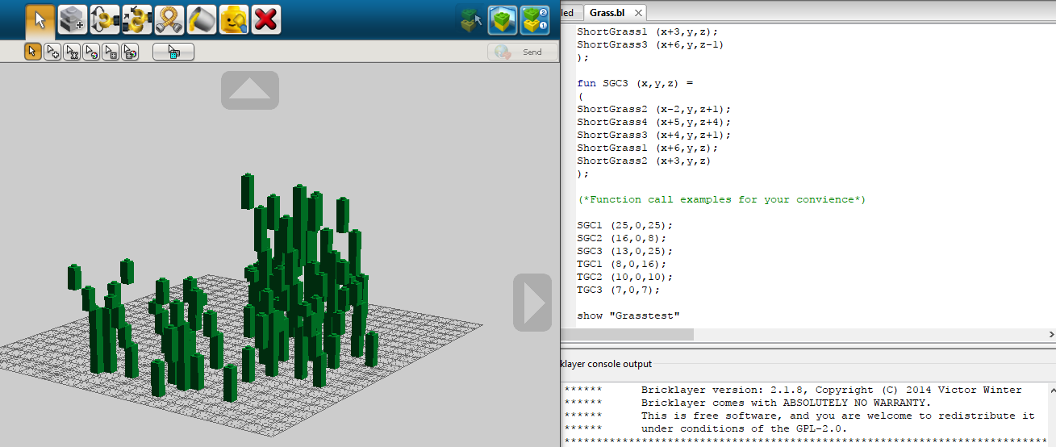
Grass Clusters

Slide 9
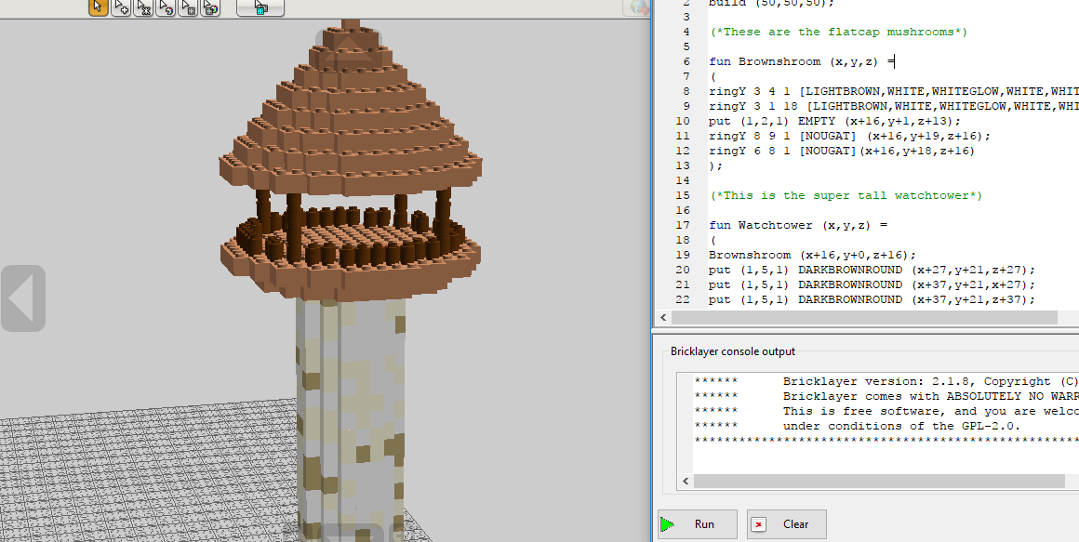
Watchtower

Slide 10
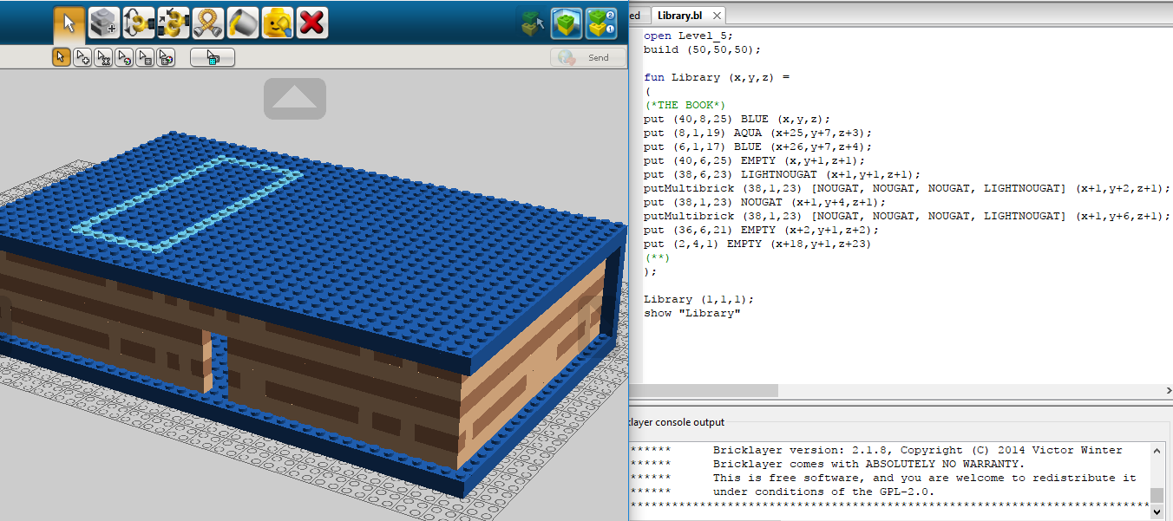
Library Book (WIP)

Slide 11
Pieter’s Creations
Log appartments
Brown Mushroom Stairs

Slide 12
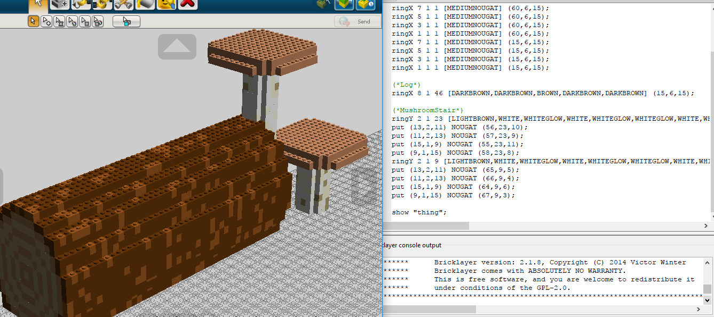
Log Apartments

